Slide 1
프로젝트_1 EMA 데이터 분석을 통한 우울증 환자 여부 예측 문제
지능기전공학부 스마트기기공학과
19011773 문이선

Slide 2



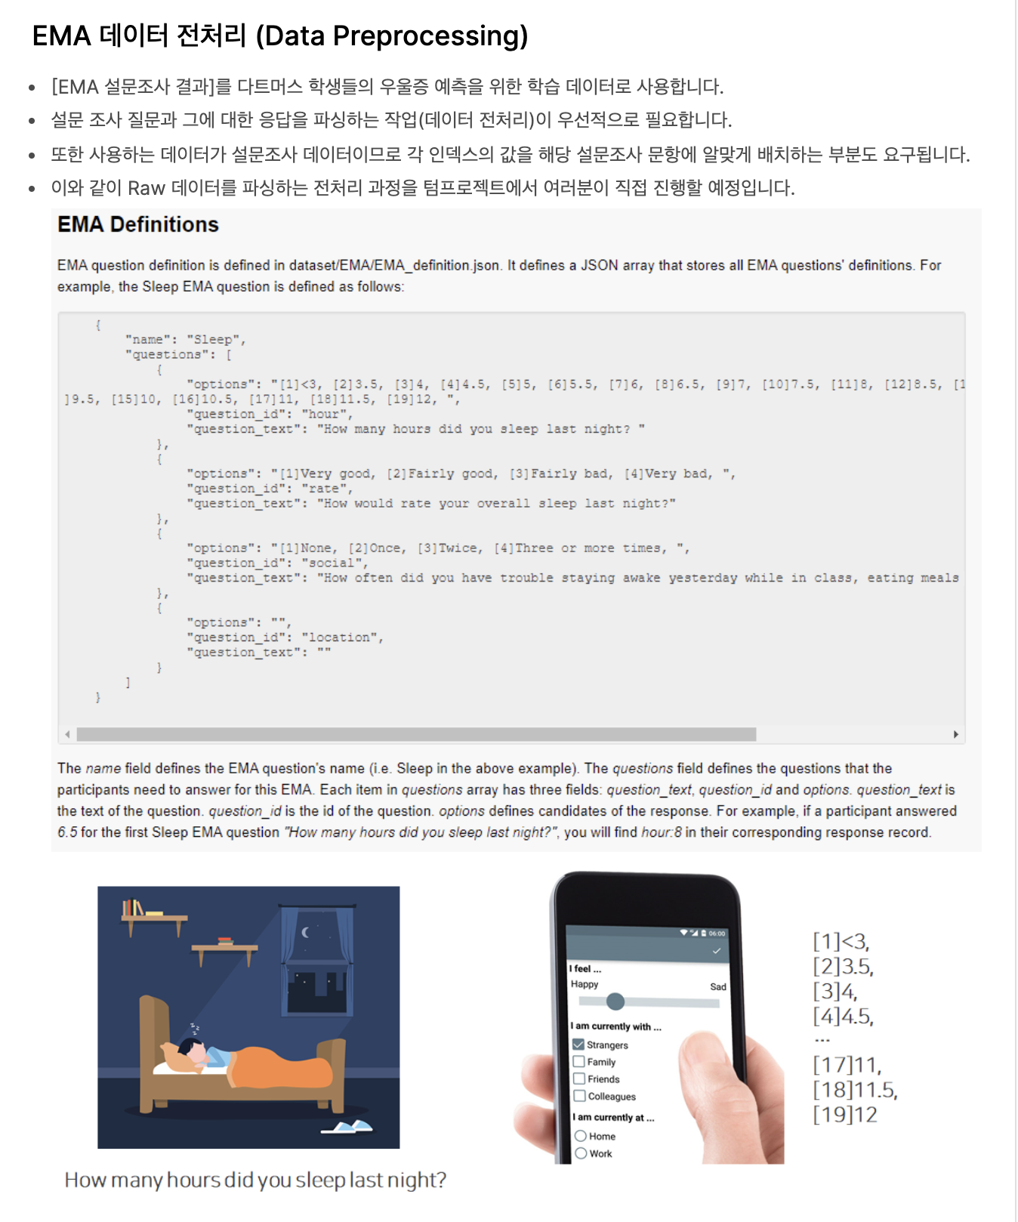

Slide 3
[module_1] Data preprocessing

Slide 4
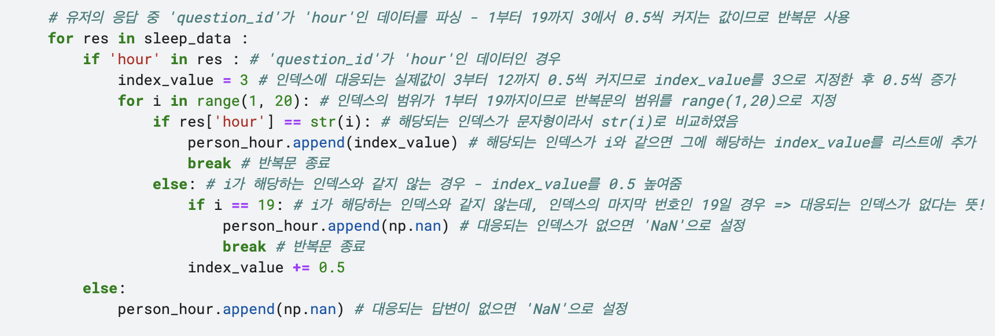
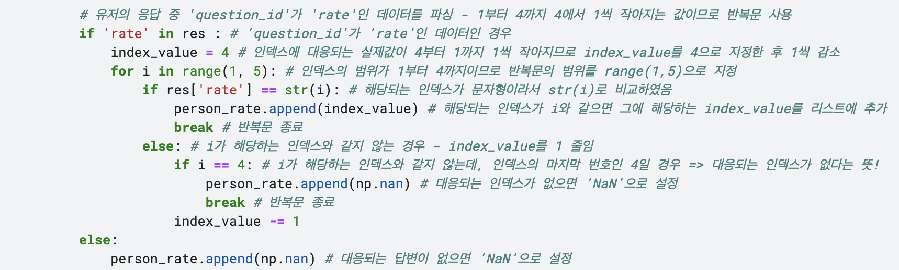
[module_1] Data preprocessing
Data : Sleep feature ( 'question_id’ : 'hour’, ‘rate’ )
## hour ##
[1] -> 3
[2] -> 3.5
[3] -> 4.0
[4] -> 4.5
...
[18] -> 11.5
[19] -> 12
## rate ##
[1] -> 4
[2] -> 3
[3] -> 2
[4] -> 1
Notes:
Person_hour = list(), person_rate = list()

Slide 5
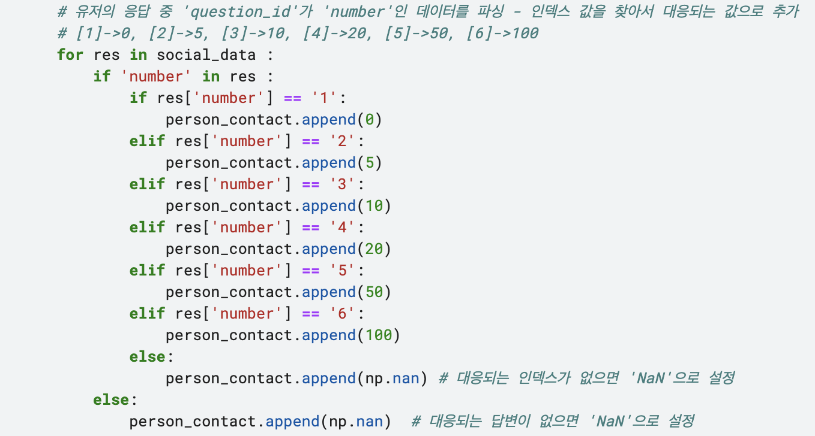
[module_1] Data preprocessing
Data : Social feature ( 'question_id’ : ‘number’ )
## number ##
[1] -> 0
[2] -> 5
[3] -> 10
[4] -> 20
[5] -> 50
[6] -> 100

Slide 6
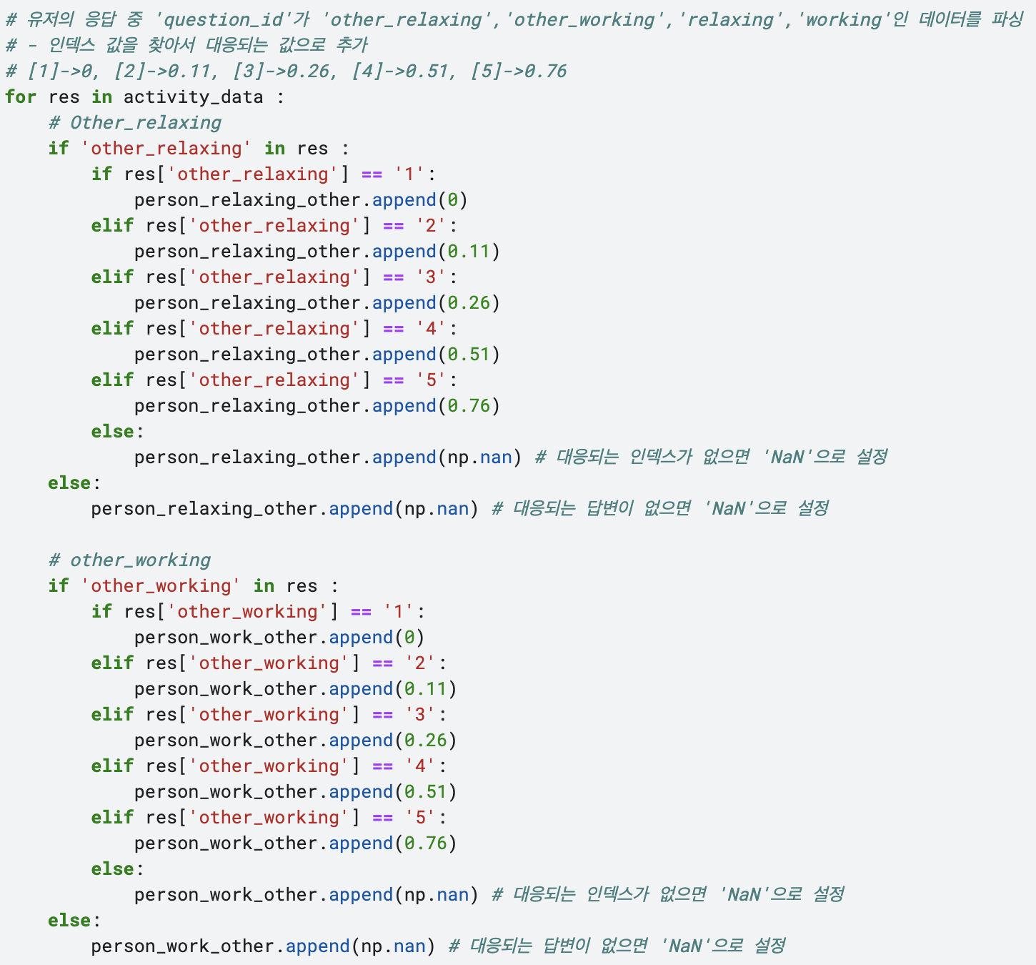
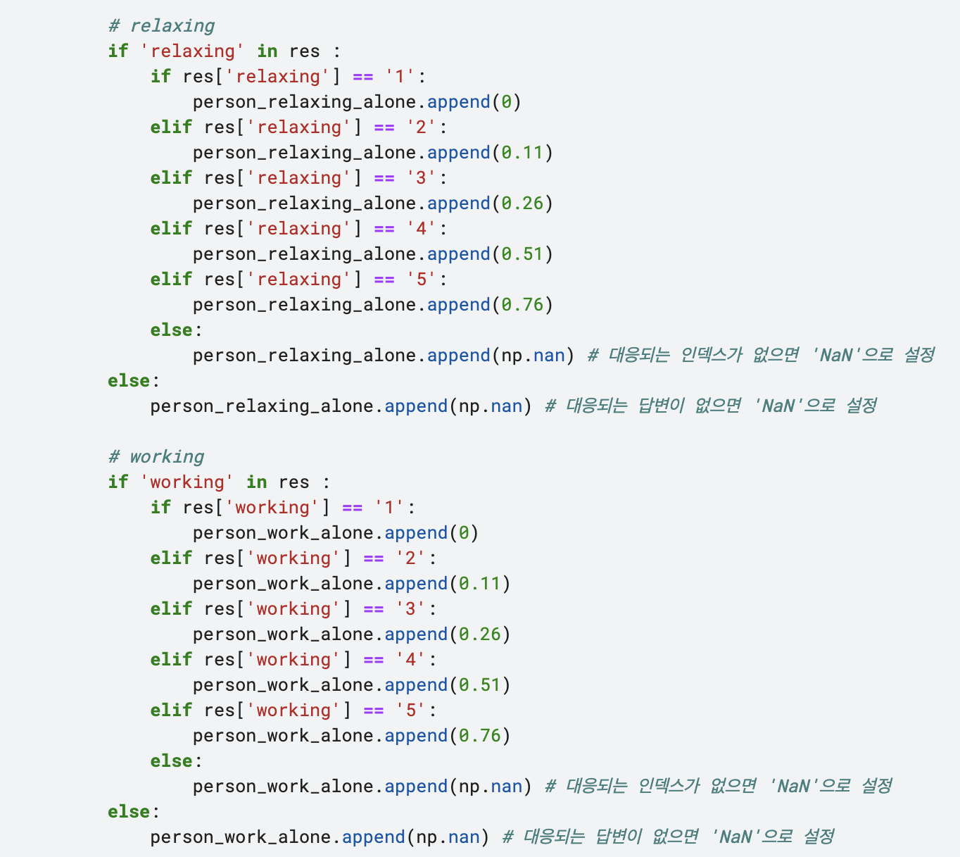
[module_1] Data preprocessing
Data : Activity feature ( 'question_id’ : 'other_relaxing’, 'other_working’, 'relaxing’, 'working')
## activity ##
[1] -> 0
[2] -> 0.11
[3] -> 0.26
[4] -> 0.51
[5] -> 0.76

Slide 7
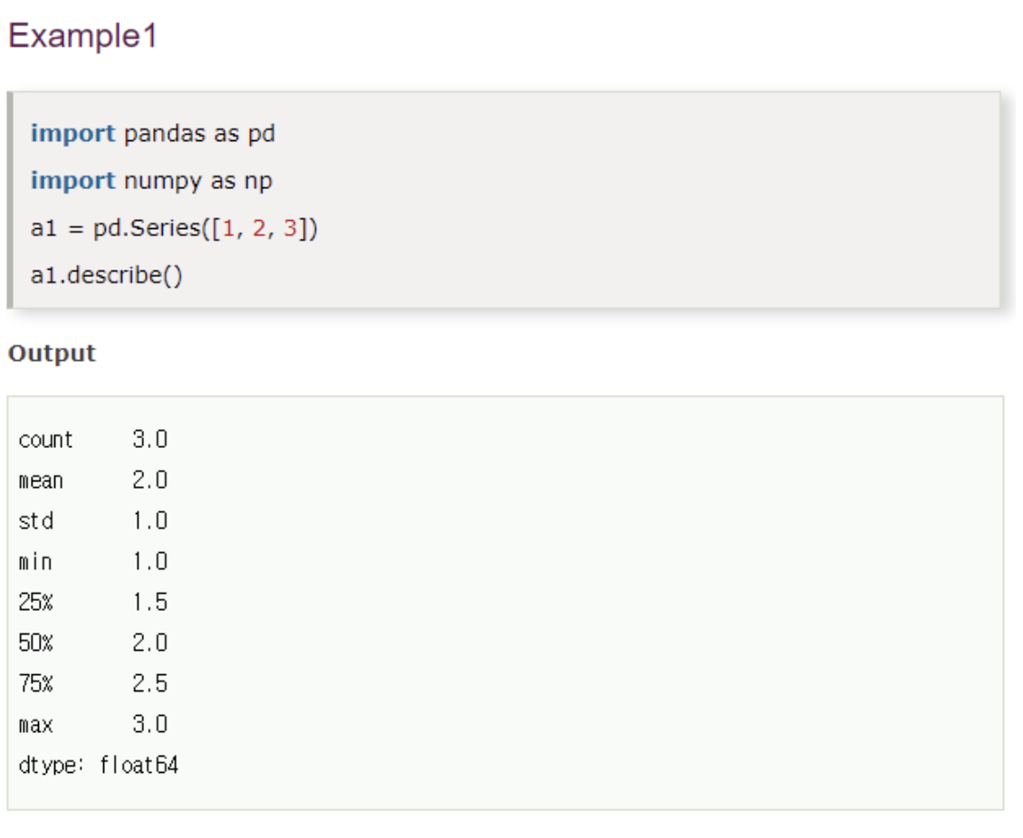
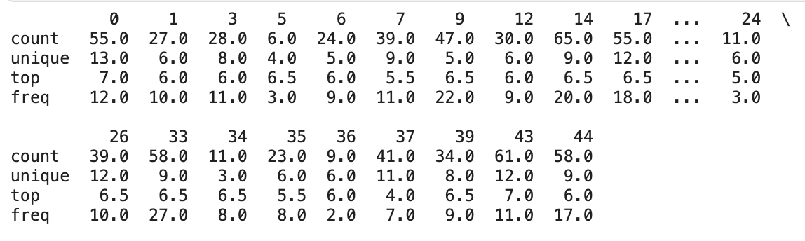
[module_2-1] Feature Extraction

Slide 8
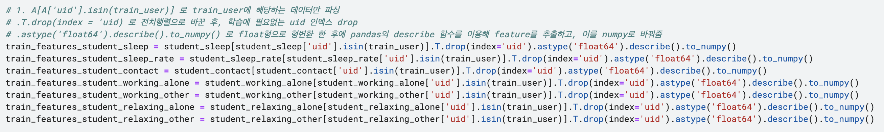
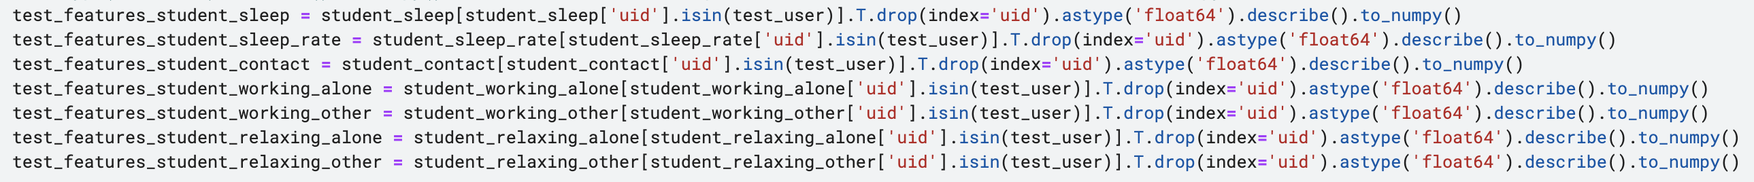
[module_2-1] Feature Extraction
Train data
Test data

Slide 9
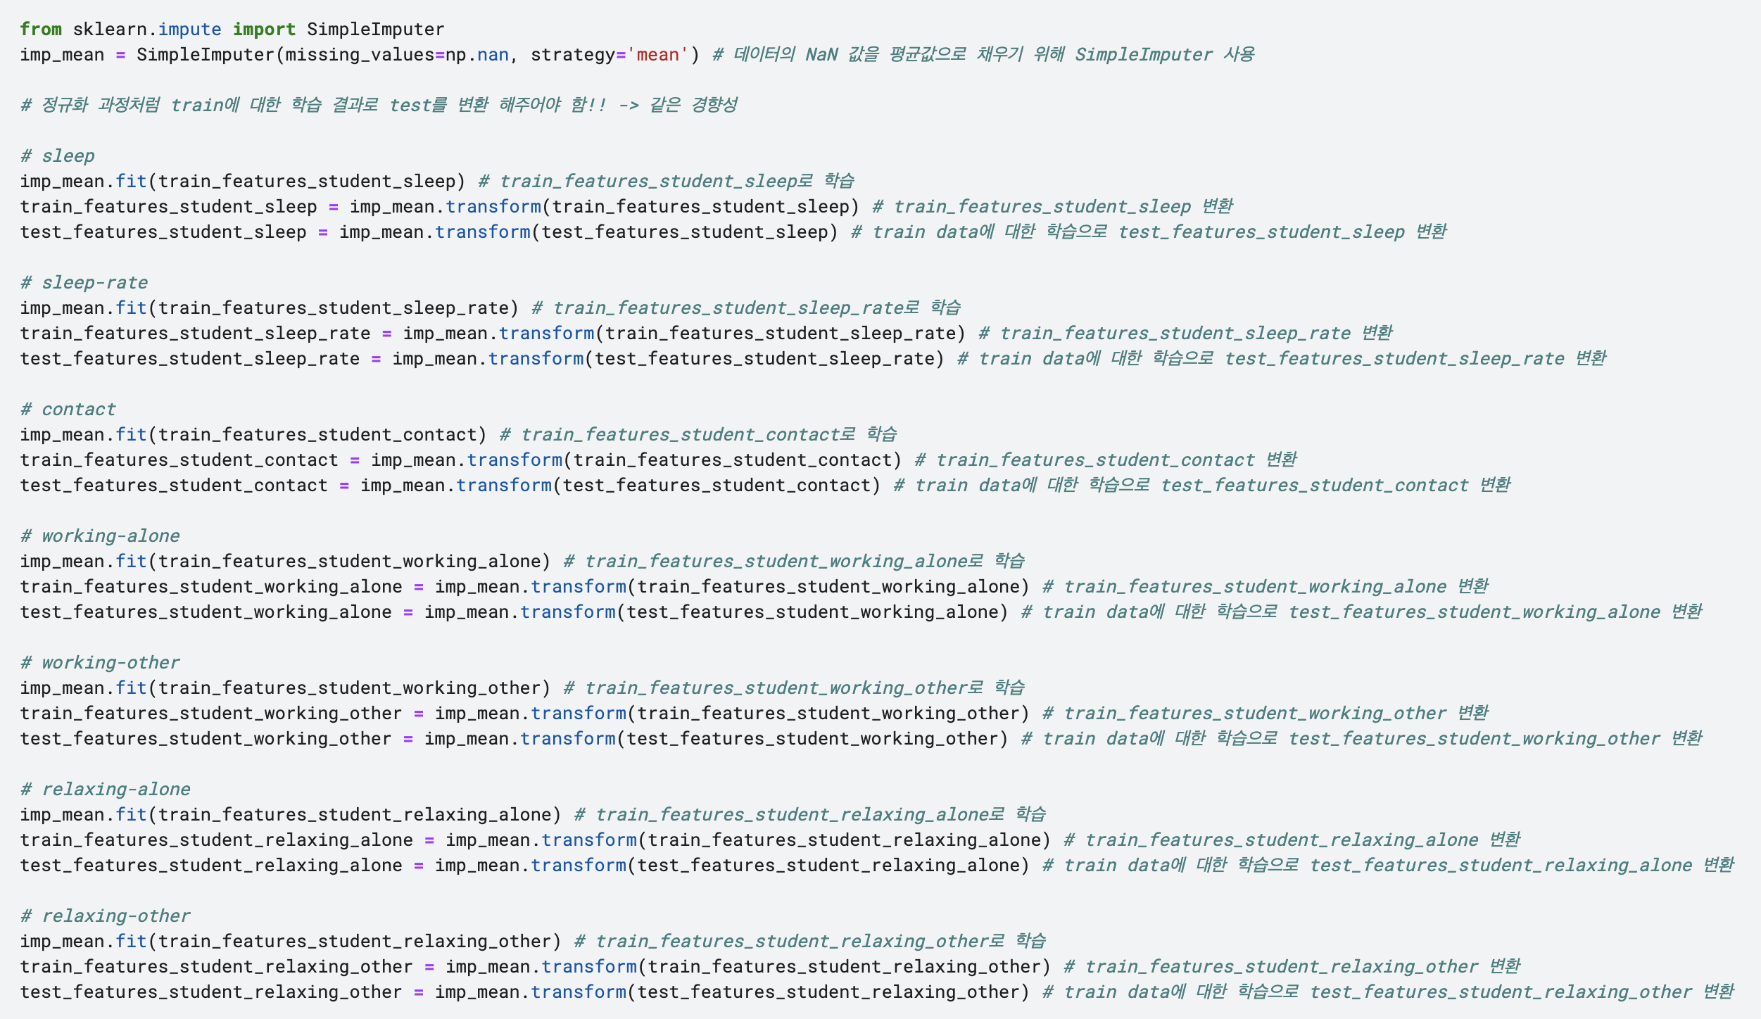
[module_2-2] Feature Extraction

Slide 10
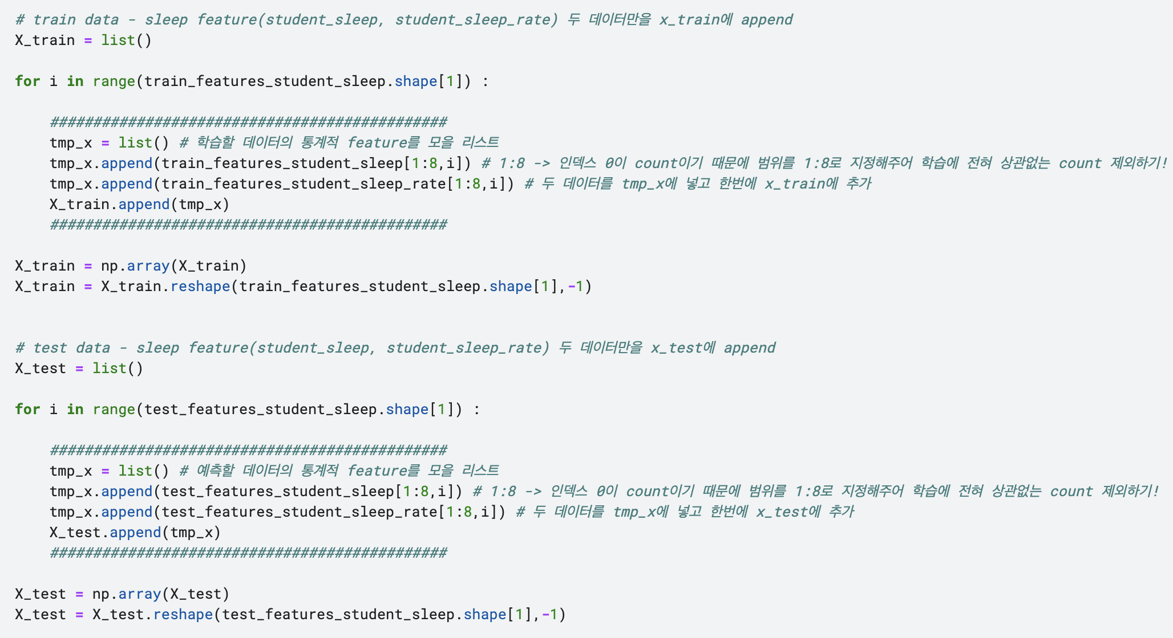
[module_3] Model training
Data : Sleep feature ( 'question_id’ : 'hour’, ‘rate’ )

Slide 11

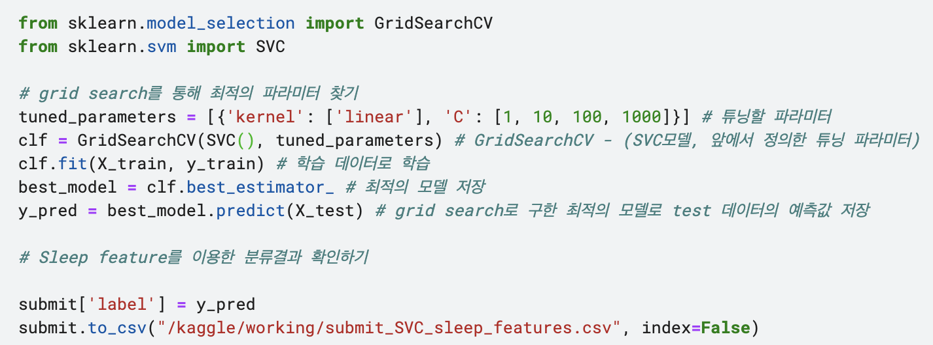
[module_3] Model training
Data : Sleep feature ( 'question_id’ : 'hour’, ‘rate’ )

Slide 12
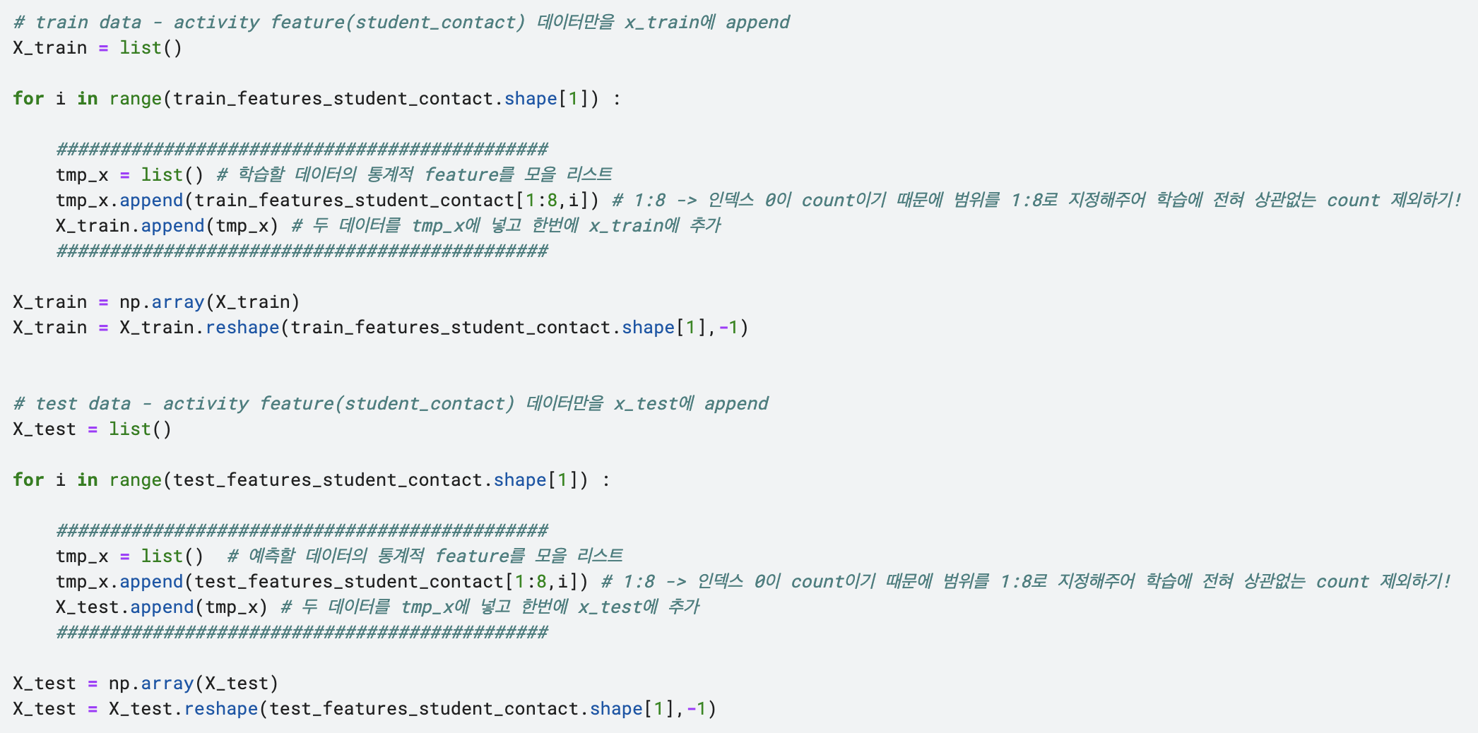
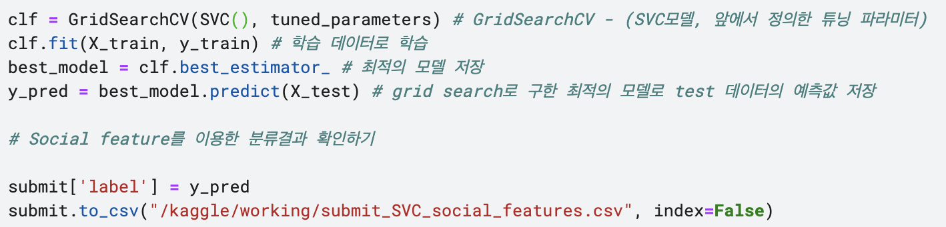
[module_3] Model training
Data : Social feature ( 'question_id’ : ‘number’ )

Slide 13
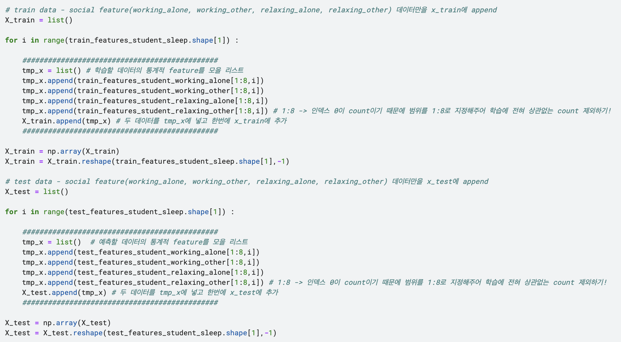
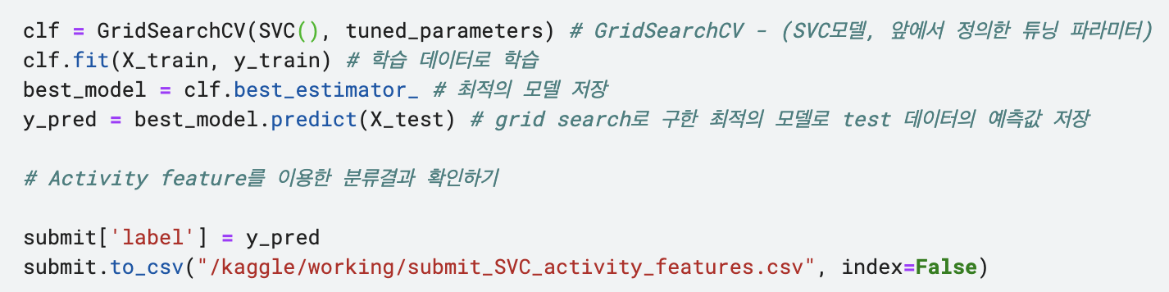
[module_3] Model training
Data : Activity feature ( 'question_id’ : 'other_relaxing’, 'other_working’, 'relaxing’, 'working')

Slide 14
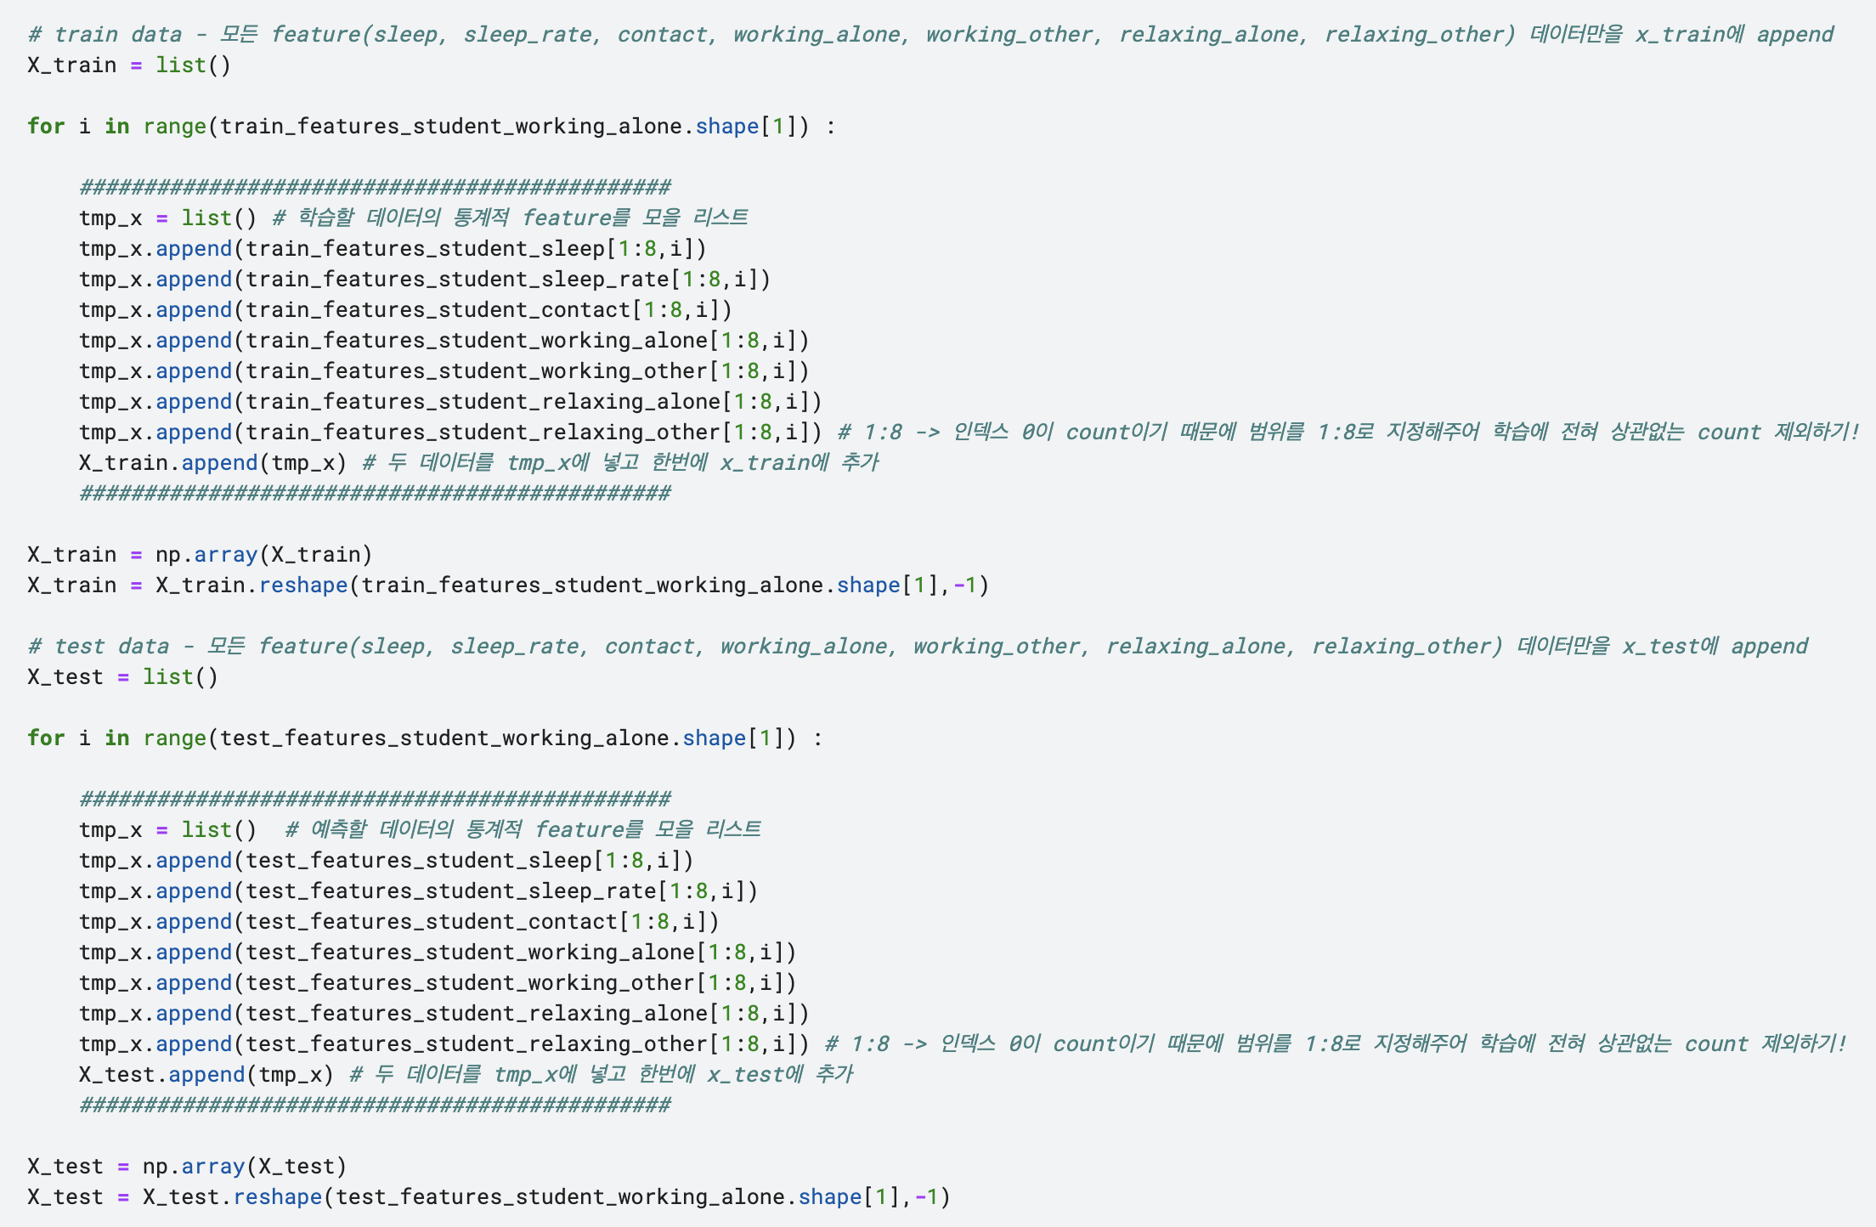
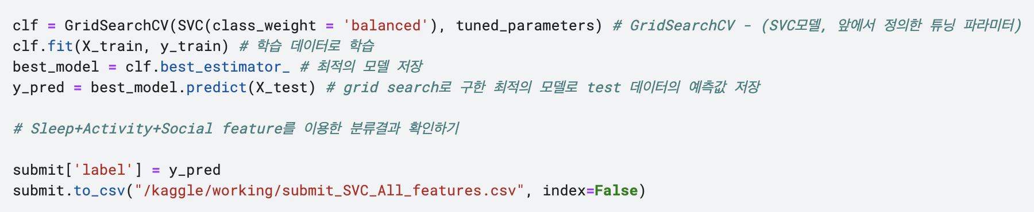
[module_3] Model training
Data : All feature ( 'question_id’ : 'hour’, ‘rate’, ‘number’, 'other_relaxing’, 'other_working’, 'relaxing’, 'working')

Slide 15
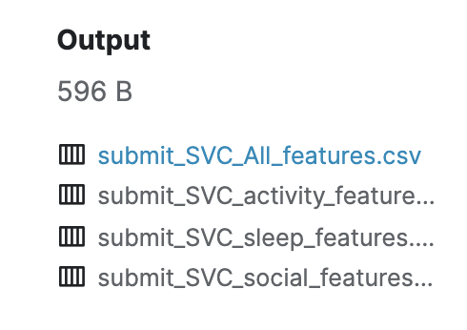

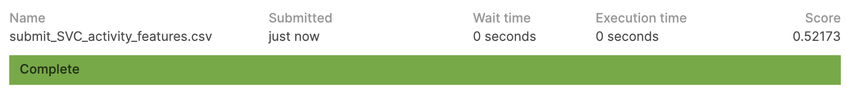
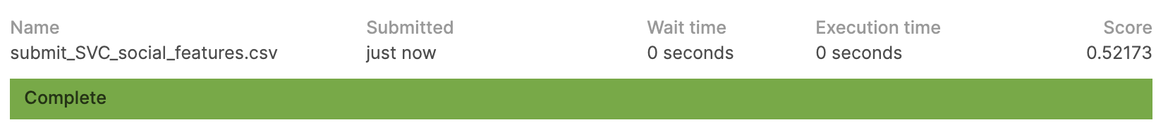

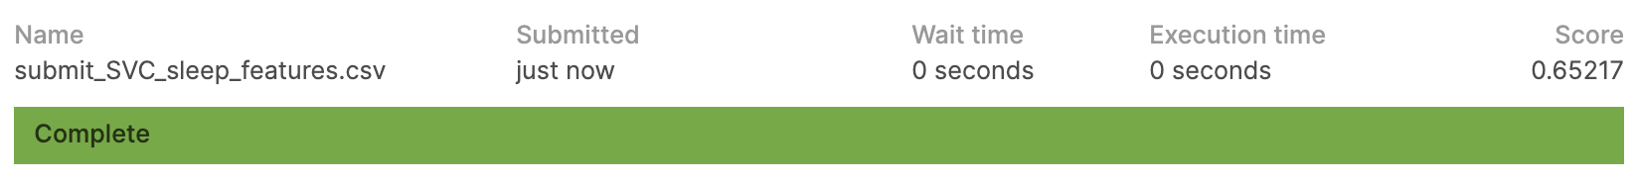
performance
Grid Search parameters : 'kernel': ['linear'], 'C': [1, 10, 100, 1000]
v. Grid Search + SVC

Slide 16

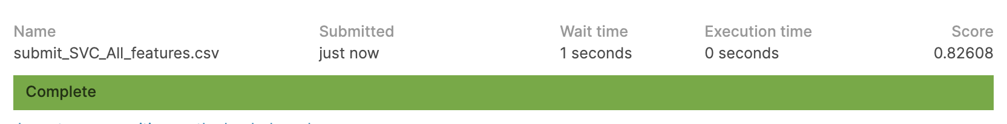
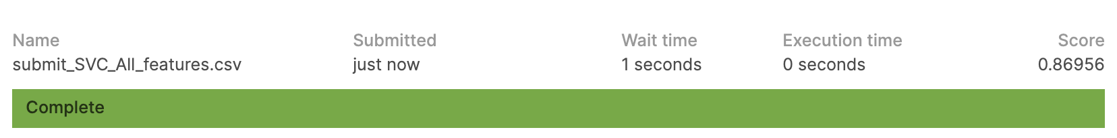
performance
Grid Search parameters : 'kernel': ['linear'], 'C': [1, 10, 100, 1000]
v. Grid Search + SVC
v. Grid Search + SVC (class_weight = 'balanced’)

